Slide 1

Computer Graphics
Lecture 1: Welcome to the Course

Slide 2
What is Computer Graphics?
Creation, Manipulation, and Storage of geometric objects (modelling) and their images (rendering)
Display those images on screens
or hardcopy devices
Image processing
Others: GUI, Haptics, Displays (VR)...

Slide 3

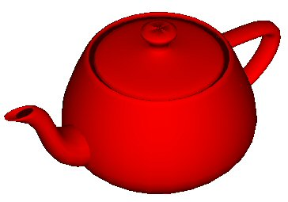
Purpose of computer graphics?
Communication is the purpose
Human perception is the context
Techniques leverage visual perception abilities
Virtual reality is great, but
Don’t want to be limited to reality
Want to do super reality
Non-photorealistic rendering (NPR) is valuable
No apology is required for “approximations”
Especially for interactive graphics

Slide 4
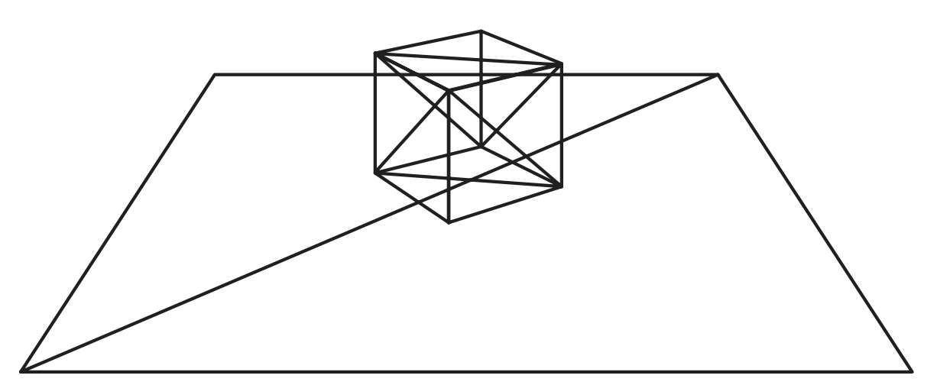
Illustration

Slide 5
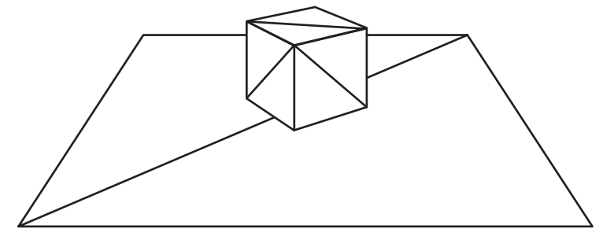
Hidden Surface Removal

Slide 6
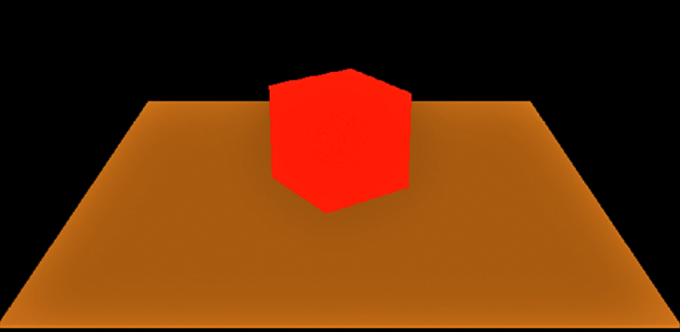
Coloring

Slide 7

Shading

Slide 8
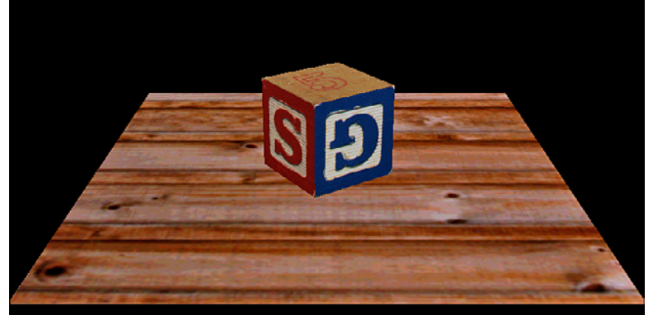
Texture Mapping

Slide 9
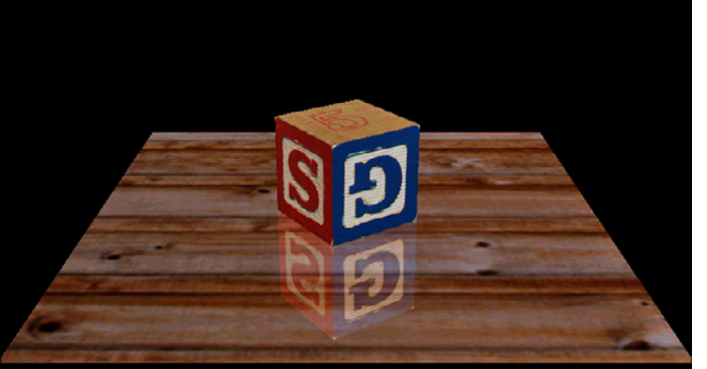
Blending

Slide 10
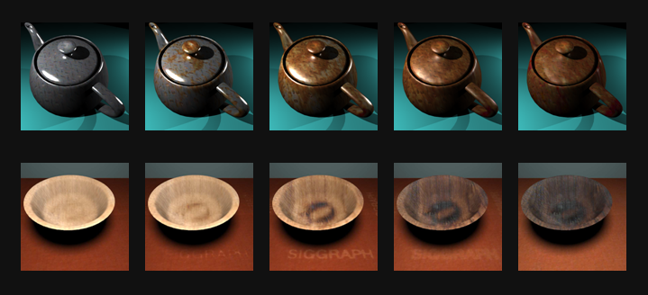
Rendering (the process of using a computer program to create a realistic or non-realistic image from a 2D or 3D model) example
Time-varying Surface Appearance: Acquisition, Modeling, and Rendering,

Slide 11
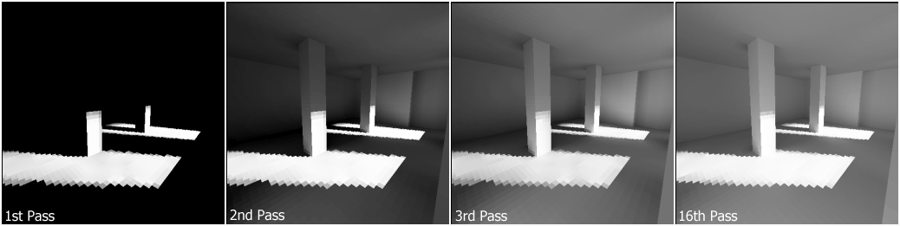
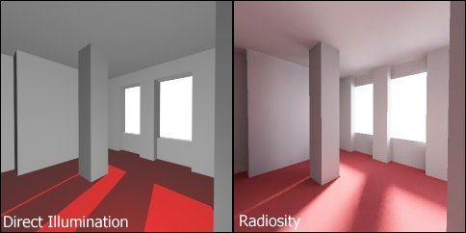
Realistic rendering

Slide 12
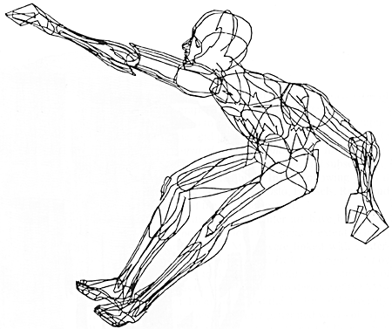
What is CG? (1/2)
Creation, storage and manipulation of models and images
Computer-generated imagery (CGI): A subset of CG that uses computer graphics to create realistic images for media like films, video games, and virtual reality.
use 3D model of human body.

Slide 13
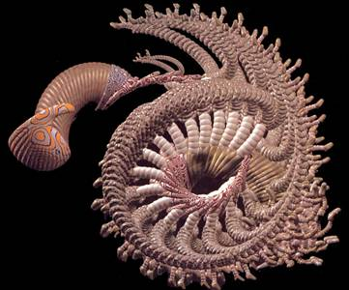
What is CG? (2/2)
Such models come from
Diverse and expanding set of fields
E.g. physical, biological, mathematical, artistic, and conceptual/abstract structures
Frame from animation by William Latham, shown at SIGGRAPH 1992. Latham creates his artwork using rules that govern patterns of natural forms.

Slide 14
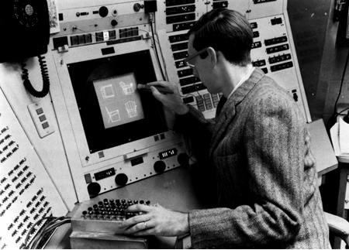
What is Interactive Computer Graphics?
User controls content, structure, and appearance of objects and their displayed images via rapid visual feedback
Input
Processing
Display
Storage
First truly interactive graphics system, Sketchpad, pioneered by Ivan Sutherland 1963 Ph.D. thesis Sketchpad, A Man-Machine Graphical Communication System

Slide 15
Graphics Hardware In Computer Graphics
CPU: Central Processing Unit. Manage all the functions of a computer.
GPU: Graphical Processing Unit. Enhance the graphical performance of the computer.
Integrated GPU vs Independent GPU
Display Output
Graphics memory, also known as Video RAM (VRAM)
Graphics APIs (OpenGL (Open Graphics Library) )

Slide 16
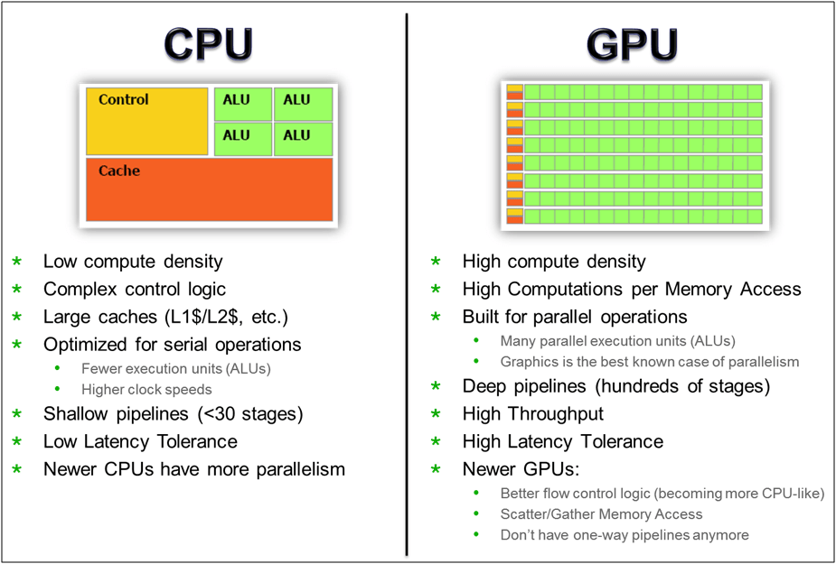
CPU vs GPU

Slide 17
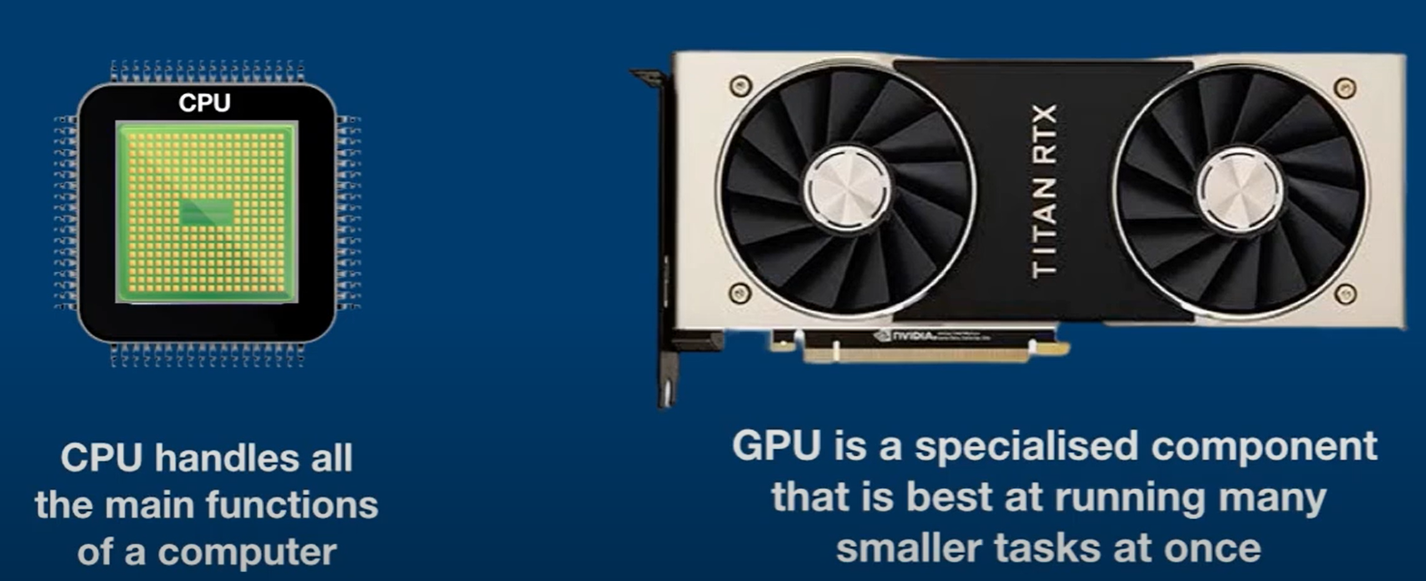
CPU vs GPU vs TPU
TPU: Tensor Processing Unit. Custom build ASIC to accelerate TensorFlow projects.

Slide 18
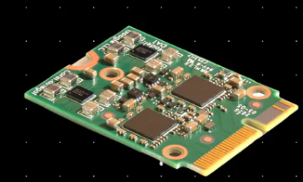
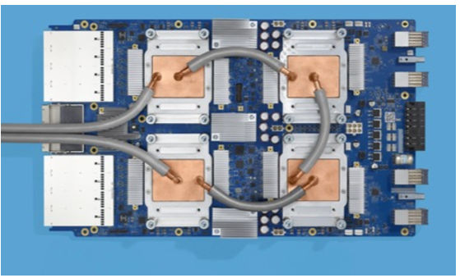
Cloud TPU: Tensor Processing Unit
application-specific integrated circuits (ASICs)
only used for TensorFlow projects by researchers and developers.
In AI/ML- The models who used to take weeks to train on GPU or any other hardware can put out in hours with TPU.

Slide 19
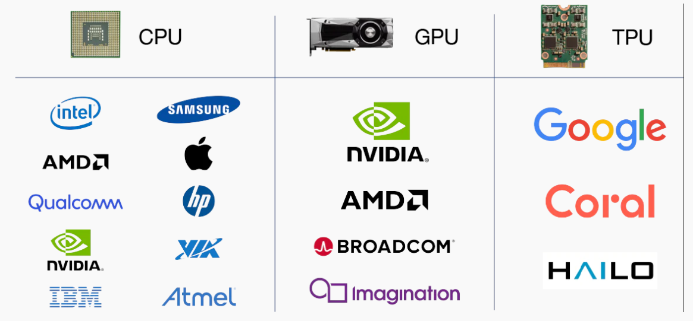
Manufacturers

Slide 20
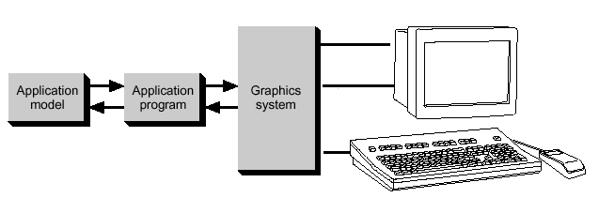
Conceptual Framework
Graphics library/package is intermediary between application and display hardware
Application program maps application objects to views
(images) of those objects by calling on graphics library.
User interaction results in modification of image and/or model
This hardware and software framework is 5 decades old but is still useful
Software
Hardware
Graphics
System/
GPU
Graphics
Library
Application
program
Application
Model / database

Slide 21





Graphics Library
Examples:
OpenGL™,
DirectX™,
Windows Presentation Foundation™ (WPF)
RenderMan™,
HTML5 + WebGL™
Primitives (characters, lines, polygons, meshes,…)
Attributes
Color, line style, material properties for 3D
Lights
Transformations

Slide 22
Thank you

